Slide 1
APOLOGETICS
IN ONE LESSON
almost
Ai1L.net
Lesson 26
Fact 3: Early Skeptics (Paul and James) Became Believers
Fact 4: the Tomb was Empty

Slide 2
Profile James and how he changes
1

Slide 3
Read the historical accounts of James’ death
2

Slide 4
James
1
Was previously a disbeliever
(John 7:5)
2
Early records indicate Jesus’ appeared to James
(1 Cor 15:7)
3
Became a leader in Jerusalem
(Gal 1:19, Acts 15:12-21)
4
Suffered and was martyred
(Josephus, Hegesippus, Clement of Alexandria)

Slide 5
Make a case for the resurrection based on Paul’s history
3

Slide 6
Read the historical accounts of Paul’s death
4

Slide 7
Paul
1
Was previously an enemy of the church
(1 Cor. 15:9-10; Gal. 1:13-16; Phil. 3:6-7; Acts 9, 22, 26)
2
Early records indicate Jesus’ appeared to Paul
(1 Cor 15:8; Acts 9, 22, 26)
3
Became a leader in the church
(Paul’s epistles, Acts)
4
Suffered and was martyred
(2 Cor 11:23-28; Phil. 1:21-23; Acts; Clement of Rome, Polycarp, Tertullian, Dionysius of Corinth, Origen)

Slide 8
Why would the evidence of former skeptics be useful?
5

Slide 9
Empty Tomb
1
Resurrection taught in the city where Jesus’ tomb was
(Acts 9)
2
Enemies attest to the empty tomb
(Matt 28:12-13; Justin Martyr; Tertullian)
3
Women are the primary sources (despite cultural objections)
(Gospels; Josephus; Talmud; Origen; Suetonius)

Slide 10
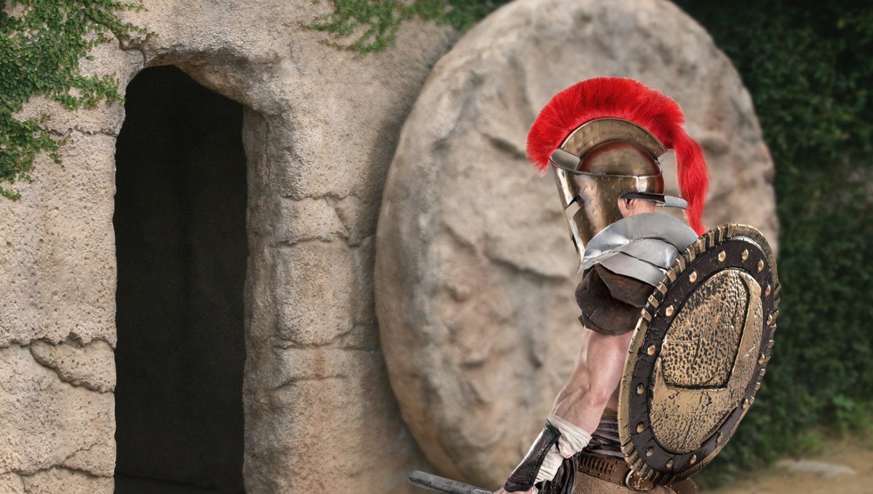
Roman Authorities Investigating Jesus For Violating Stay-In-Tomb Order
BABYLON BEE April 12th, 2020 http://bit.ly/Ai1LStayInTomb

